Slide 1
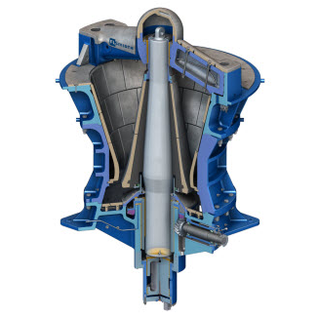
MineCo Gyratory Crusher Optimization
Storytelling example for Coursera C1 final project (milestone 3)
Dr. Teresa Escrig

Slide 2
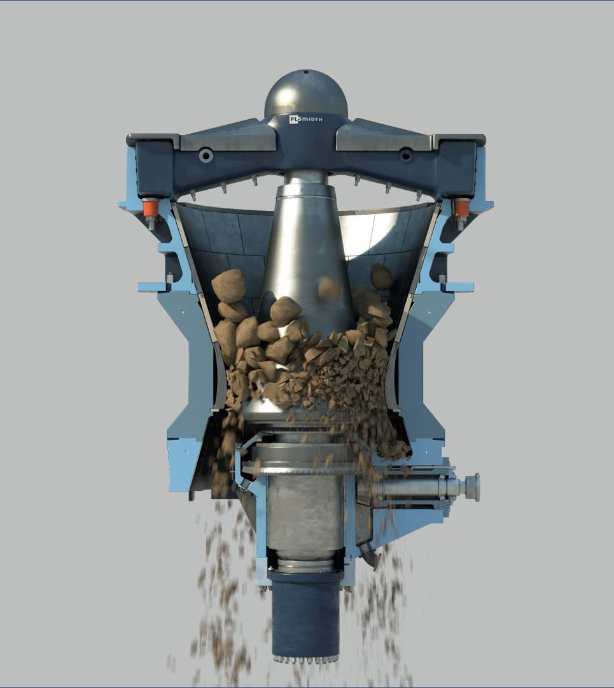
MineCo Gyratory Crusher Optimization Use case overview
MineCo mines precious metals from ore.​
The first step of the process is crushing the rocks.
Manual supervisory control.
Rocks size and hardness and the condition of the liner vary with an unknown random distribution.
The objective is to maximize the throughput of fragmented ore.
Notes:
Link to the video:

Slide 3

MineCo Gyratory Crusher Optimization Business Value
A 5% improvement in throughput = $10M / year per mine
General Manager: Tomas
Notes:
Link to the video:

Slide 4

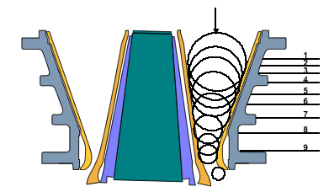
MineCo Gyratory Crusher Optimization Current methods and their limitations
Expert operator: Robert
CURRENT METHODS
Human operator – supervisory control. Leads to suboptimal results and is time intensive.
PID & MPC controllers – low level control
I WANT TO RETIRE!
LIMITATIONS
Changing particle size and hardness distribution of incoming ore
Manual control that takes many years to master
Large performance discrepancy between novice and expert operators

Slide 5

MineCo Gyratory Crusher Optimization Goals, KPI, Autonomous AI methods to be used
GOALS, KPI
Maximize (throughput)
Measured in tons / hour
The throughput is the amount of material that passes through the crusher <= 65mm fineness
AUTONOMOUS AI METHODS
Math - same PID & MPC controllers
Machine Learning – advance perception
Deep Reinforcement Learning – for 2 strategies
When particle sizes are larger and /or ore is harder, choke the crusher (fill it up to the top)
When incoming particle sizes are smaller and / or ore is softer, regulate the crusher (fill it up to 2/3)

Slide 6

MineCo Gyratory Crusher Optimization Autonomous AI superpowers
Makes human-like decisions
Perceives, then acts
Learns and adapts
Infers from experience
Improvises and strategizes
General Manager: Tomas

